Slide 1
Chaotic System and Lorenz Attractor
Anny Cui

Slide 2
Contents
Background
Chaotic Theory
Discovery of the Lorenz Attractor
Methods
Lorenz Equations
Numerical methods used to solve and simulate the system
Results
Discussion

Slide 3
Background

Slide 4
Does the flap of a butterfly’s wings in Brazil set off a tornado in Texas?
By Edward Norton Lorenz (1972)
Butterfly Effect: a minor change in one state of a deterministic nonlinear system can result in large differences in a later state.

Slide 5
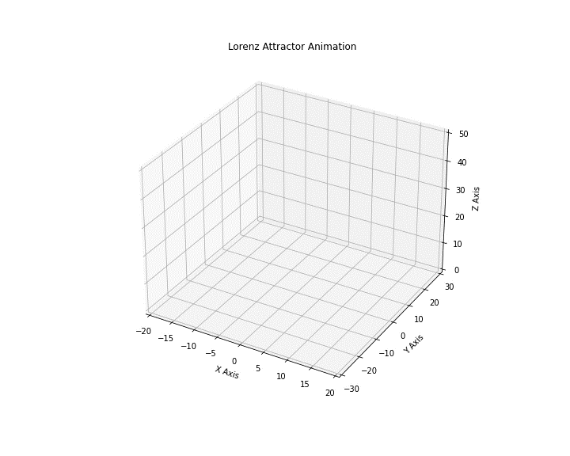
Chaotic Theory
It studies the unpredictable and complex dynamics of systems sensitive to initial conditions.
Lorenz Attractor:
The set of chaotic solutions
How chaos can arise from a simple system of equations.
Who is Edward Lorenz?
Meteorologist and Mathematician
Stumbled upon chaos theory while modeling weather patterns (1960s and 70s).

Slide 6
Methods

Slide 7
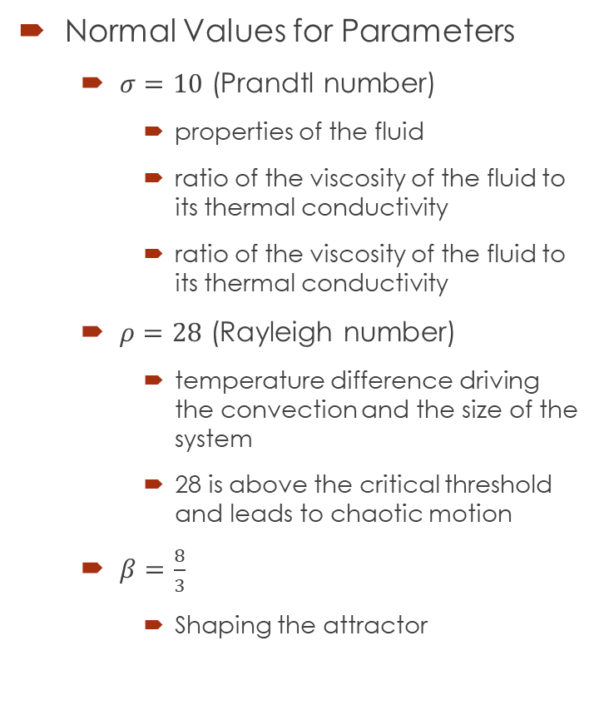
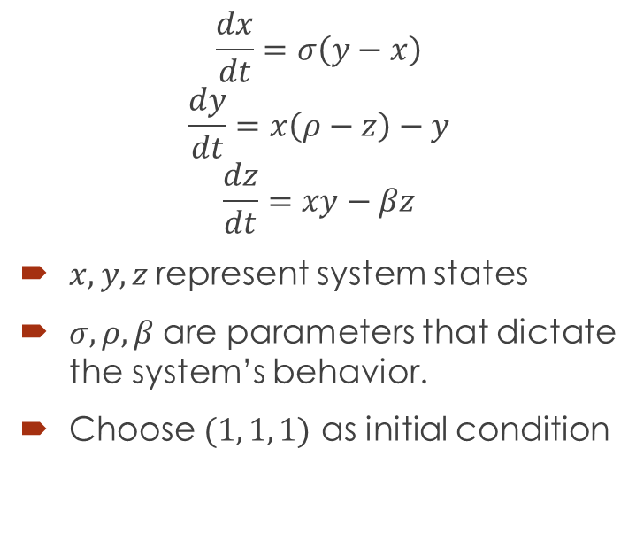
Lorenz System
Normal Values for Parameters
$σ=10$ (Prandtl number)
properties of the fluid
ratio of the viscosity of the fluid to its thermal conductivity
ratio of the viscosity of the fluid to its thermal conductivity
$ρ=28$ (Rayleigh number)
temperature difference driving the convection and the size of the system
28 is above the critical threshold and leads to chaotic motion
$β=\frac{8}{3}$
Shaping the attractor
$$\frac{dx}{dt}=σ\left(y−x\right)$$
$$\frac{dy}{dt}=x\left(ρ−z\right)−y$$
$$\frac{dz}{dt}=xy−βz$$
$x, y, z$represent system states
$σ, ρ, β$ are parameters that dictate the system’s behavior.
Choose $(1, 1, 1)$ as initial condition

Slide 8
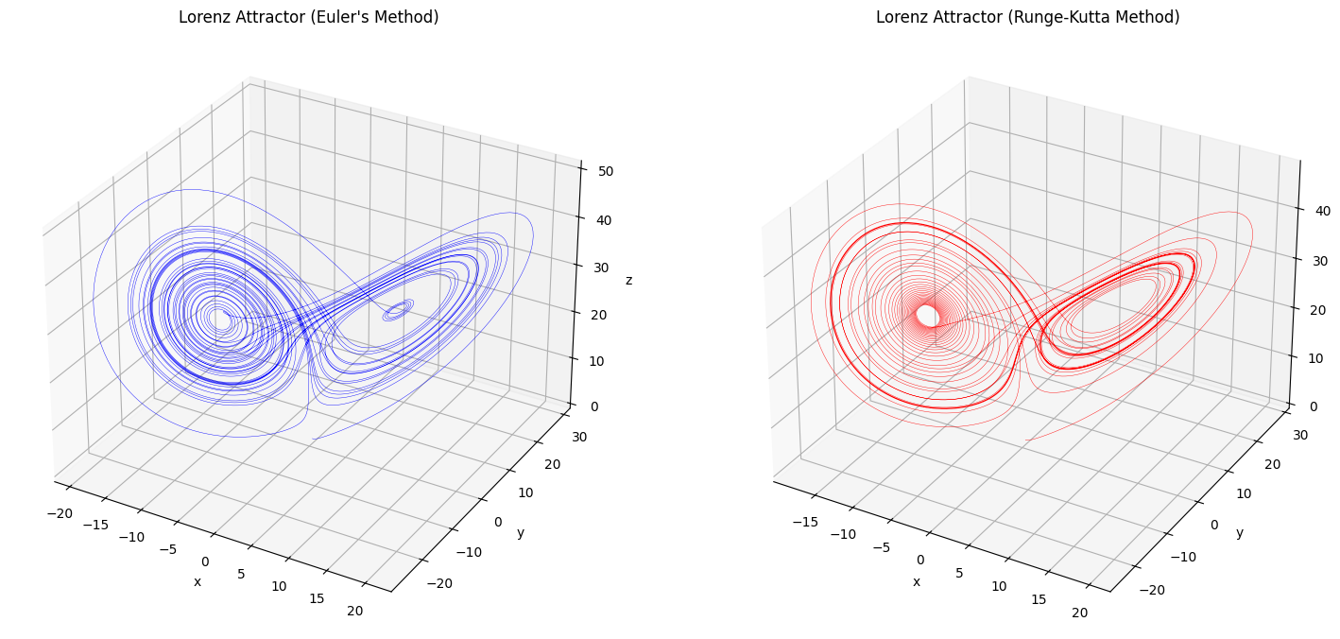
Numerical Methods

Slide 9
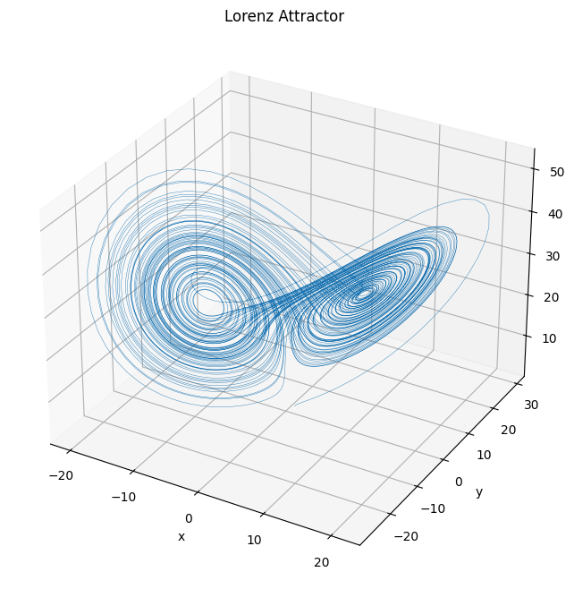
Results

Slide 10
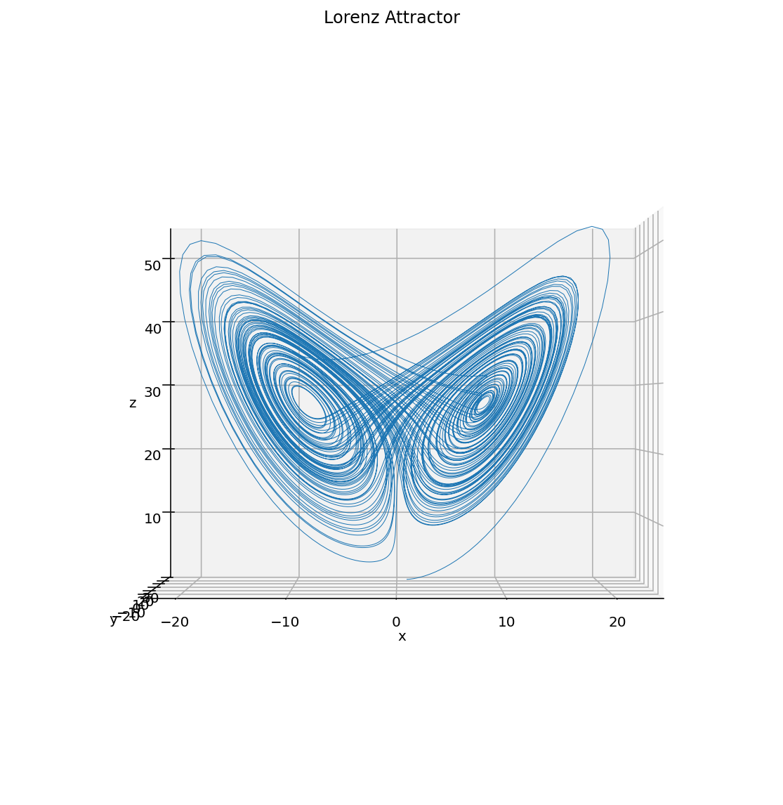
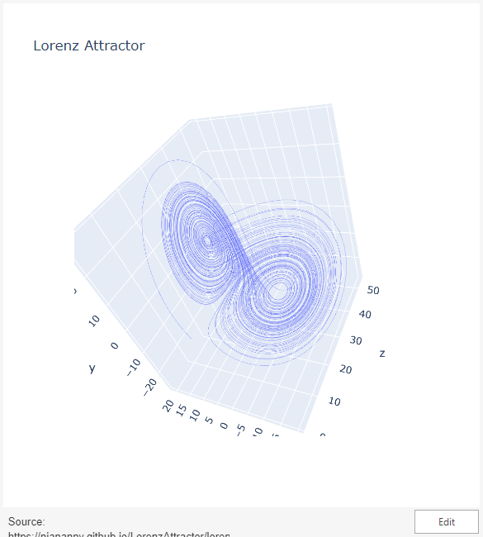
Projections
x-axis: convective intensity (x)
y-axis: temperature difference between ascending and descending currents (y)
z-axis: deviation of temperature profile from a linear gradient (z)
Interactive Plot (Right)

Slide 11
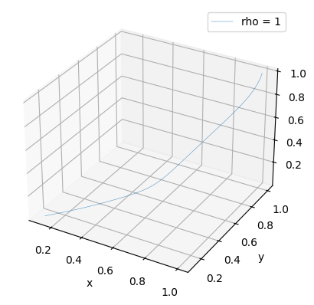
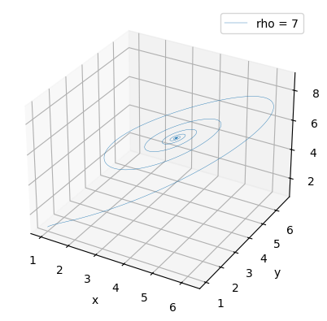
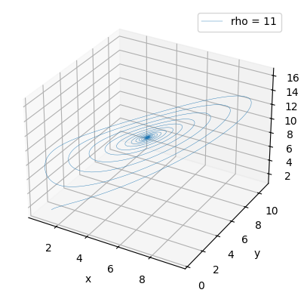
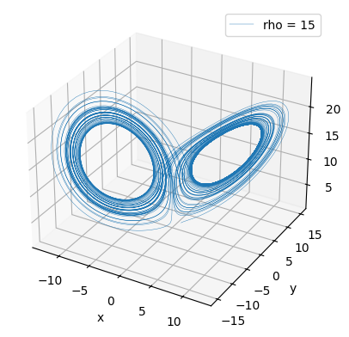
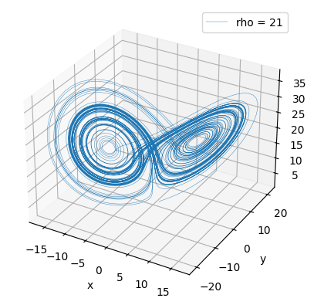
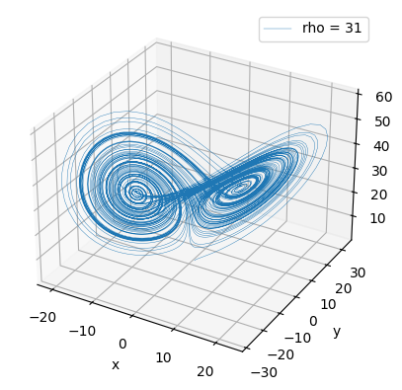

Slide 12
Discussion

Slide 13
Sensitive Dependence on Initial Conditions
A hallmark of chaos
Meteorological Insight:
The attractor's structure helps explain why weather is inherently unpredictable beyond a certain time frame.
Mathematical Insight:
It provides an example of how non-linear dynamics can lead to complex patterns, even from simple deterministic systems.

Slide 14
Thank You!

